Slide 1
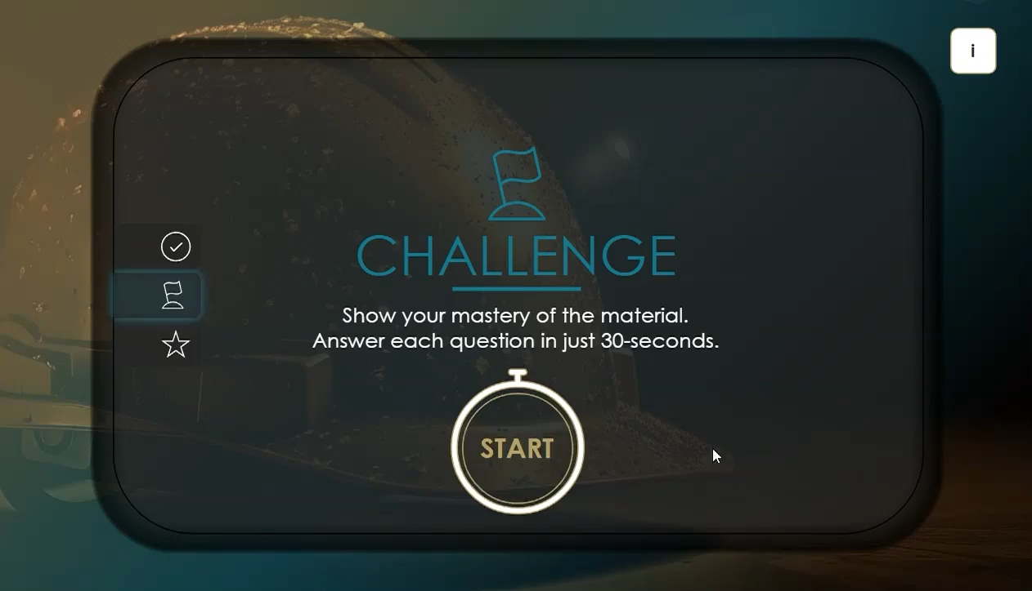


Assessment and Continuous Improvement
Analyse assessment data to identify learning gaps.
Refine content for continuous educational effectiveness.
Notes:
Video will play in background while you talk …
Every learning experience we create includes a deliberate assessment strategy—designed upfront, not added in at the end. This means we’re measuring the right things, in the right way, at the right time.
These assessments help us understand how well the learning is landing—where learners are thriving, and where they might need more support. From there, we analyze that data and use it to refine the content continuously.
That way, your training stays relevant, effective, and always aligned with your goals—whether it’s boosting performance, driving behaviour change, or meeting compliance needs.
CLICK to continue …

